Slide 1
Chapter 13:
Overloading

Slide 2
Objectives
In this chapter, you will
  Learn about overloading
  Become familiar with the restrictions on operator overloading
  Examine the pointer this
  Learn about friend functions
  Learn how to overload operators as members and nonmembers of a class
C++ Programming: From Problem Analysis to Program Design, Seventh Edition

Slide 3
Objectives (cont’d.)
In this chapter, you will (cont’d.)
  Discover how to overload various operators
  Become familiar with the requirements for classes with pointer member variables
C++ Programming: From Problem Analysis to Program Design, Seventh Edition

Slide 4
Operators in C++
The C++ operators (+,-,/,*,…) work in predefined ways when used with built-in data types.
  When the + operator is used with two int variables it performs an integer addition operation (10+20)
  When the + operator is used with two double variables it preforms a floating-point addition operation (10.5+20.6)
C++ Programming: From Problem Analysis to Program Design, Seventh Edition

Slide 5
Operator Overloading
C++ also allows you to use standard operators (+,-,/,*,…) with objects of classes provided that you have to define the exact action that a given operator is to perform.
Defining the way that an operator works with objects of a particular class is known as operator overloading.
  This defining includes function’s header and body
C++ Programming: From Problem Analysis to Program Design, Seventh Edition

Slide 6
Why Operator Overloading Is Needed
Assignment and member selection are the only built-in operations on classes
  Other operators cannot be applied directly to class objects
Operator overloading: extends definition of an operator to work with a user-defined data type
  C++ allows you to extend the definitions of most of the operators to work with classes
C++ Programming: From Problem Analysis to Program Design, Seventh Edition

Slide 7
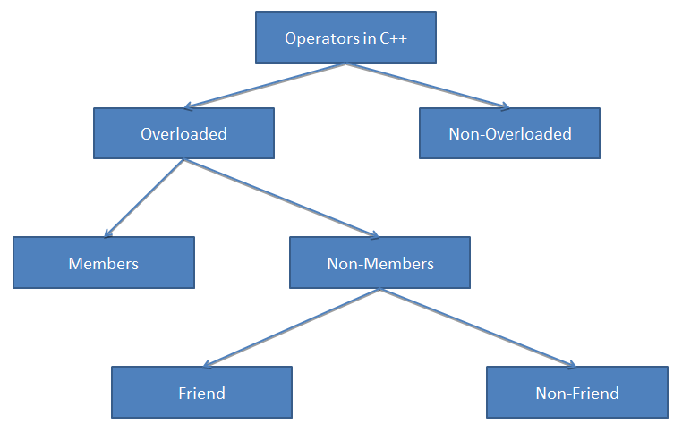
How to Implement Operator Overloading
C++ Programming: From Problem Analysis to Program Design, Seventh Edition

Slide 8
Syntax for Operator Functions
Syntax of an operator function heading:
  It is a value-returning function
  operator is a reserved word
To overload an operator for a class:
  Include operator function declaration in the class definition
  Write the definition of the operator function
C++ Programming: From Problem Analysis to Program Design, Seventh Edition

Slide 9
Operator Overloading as Member Functions
C++ Programming: From Problem Analysis to Program Design, Seventh Edition

Slide 10
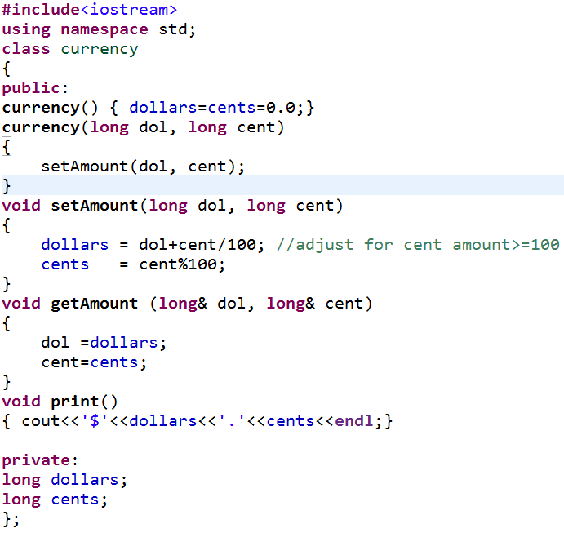
Overloading as Member Functions: Arithmetic Binary Operators
C++ Programming: From Problem Analysis to Program Design, Seventh Edition

Slide 11
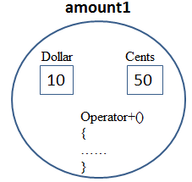
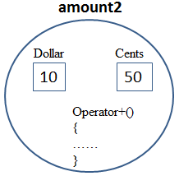
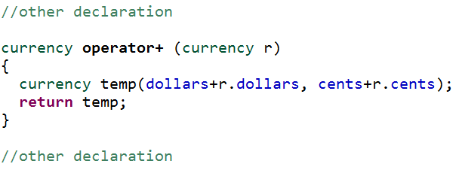
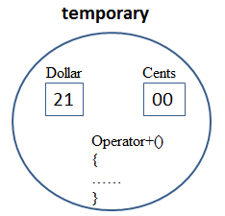
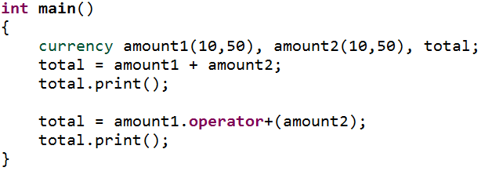
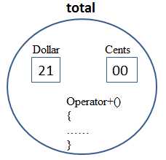

Overloading as Member Functions: Arithmetic Binary Operators [cont’d]
Overloading addition operation (+)
+
Generated by compiler
=
OUTPUT
C++ Programming: From Problem Analysis to Program Design, Seventh Edition

Slide 12
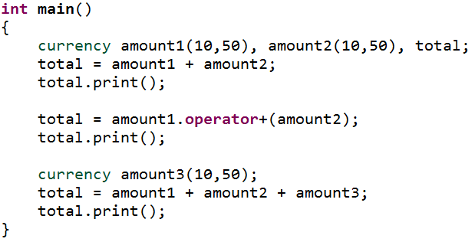

Overloading as Member Functions: Arithmetic Binary Operators [cont’d]
Overloading addition operation (+)
OUTPUT
C++ Programming: From Problem Analysis to Program Design, Seventh Edition

Slide 13
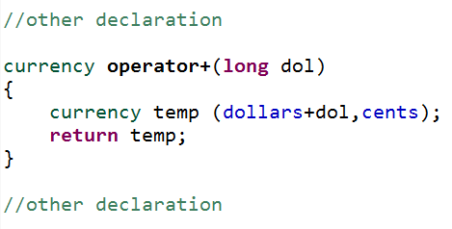

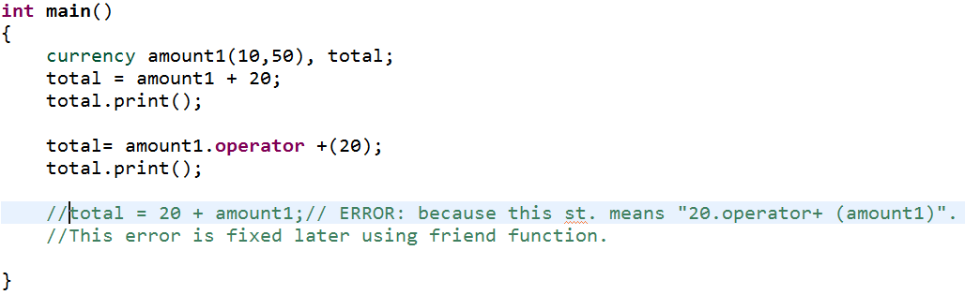
Overloading as Member Functions: Arithmetic Binary Operators [cont’d]
Overloading addition operation (+) with
OUTPUT
C++ Programming: From Problem Analysis to Program Design, Seventh Edition

Slide 14

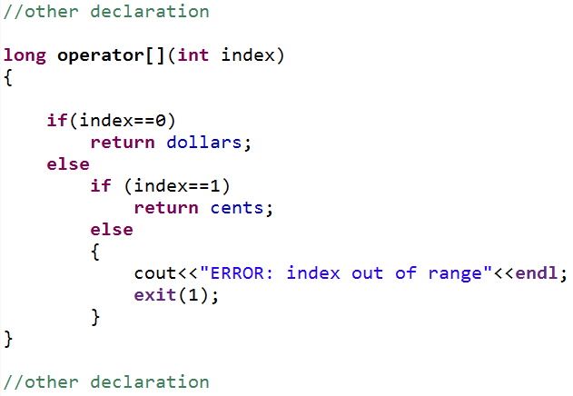
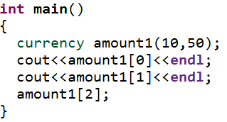
Overloading as Member Functions: Binary Operators
Overloading [ ]
OUTPUT
C++ Programming: From Problem Analysis to Program Design, Seventh Edition

Slide 15
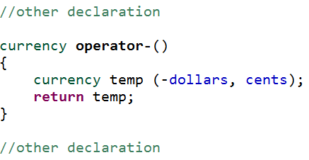

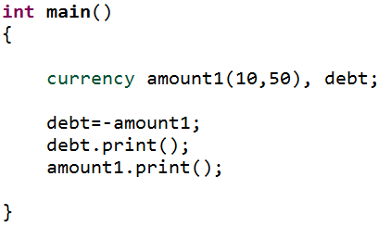
Overloading as Member Functions: Unary Operators
Overloading minus operator (-)
OUTPUT
C++ Programming: From Problem Analysis to Program Design, Seventh Edition

Slide 16
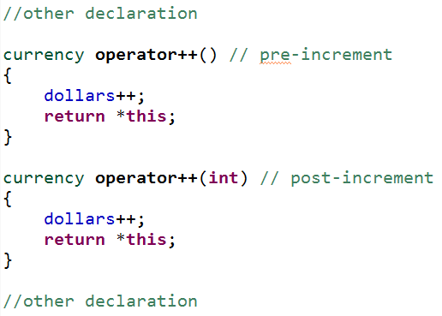
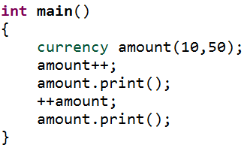

Overloading as Member Functions: Unary Operators [cont’d]
Overloading pre-increment/post-increment (++)
OUTPUT
C++ Programming: From Problem Analysis to Program Design, Seventh Edition

Slide 17
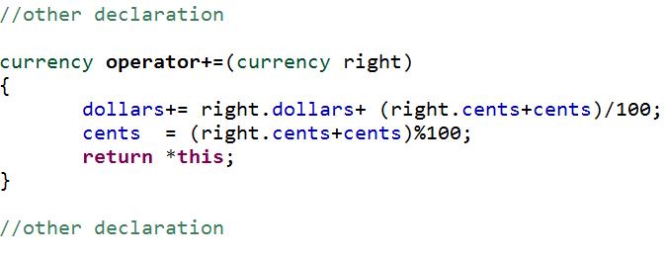
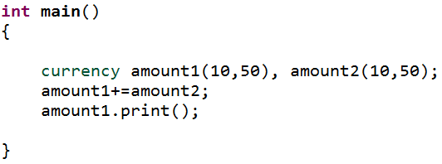
Overloading as Member Functions: Unary Operators [cont’d]
Overloading (+=) operator
OUTPUT
C++ Programming: From Problem Analysis to Program Design, Seventh Edition

Slide 18
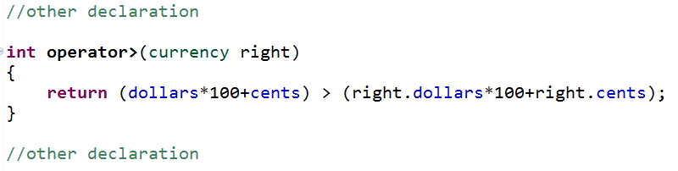
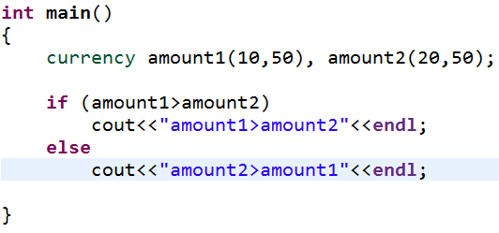
Overloading as Member Functions: Logical Binary Operators
Overloading (>) operator
OUTPUT
C++ Programming: From Problem Analysis to Program Design, Seventh Edition

Slide 19
END PART I
C++ Programming: From Problem Analysis to Program Design, Seventh Edition

